Slide 1
Cs-381 Software Engineering
Course Instructor: Dr. Shazia Arshad
Notes:
Welcome to all of you in this course. I am Dr. Shazia Arshad. I will be your instructor for this course.

Slide 2
Class Diagram
Describe the structure of the system in terms of classes and objects.
Provide details of how the classes interact with each other.
What is a Class??
A class is a blueprint for an object.
A general template that we use to create specific instances or objects in the application domain

Slide 3
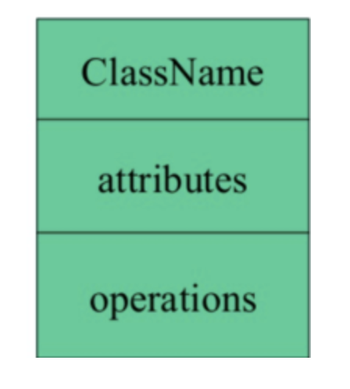
ELEMENTS OF Class Diagram
Class is represented as a rectangular box containing following components.
Class Name:
Attributes:
Operations (Methods)

Slide 4
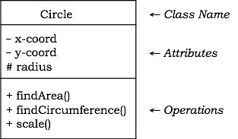
1- Class Name
It appears in the topmost section.
A class name should always start with a capital letter.
A class name should always be in the center of the first compartment.
A class name should always be written in bold format.
An abstract class name should be written in italics format.

Slide 5
2- Attributes
Attributes are shown in the second partition.
Properties of the class about which we want to store information
Represents a piece of information that is relevant to the description of the class.
These are properties that separates one instance of a class from another.
Attributes must have a meaningful name that describes the use of it in a class.
The attribute type is shown after the colon.

Slide 6
3- Operations
Operations are shown in the third partition.
Represents the actions or functions that a class can perform
Operations are called functions.
The return type of a method is shown after the colon at the end of the method signature.
The return type of method parameters are shown after the colon following the parameter name.

Slide 7
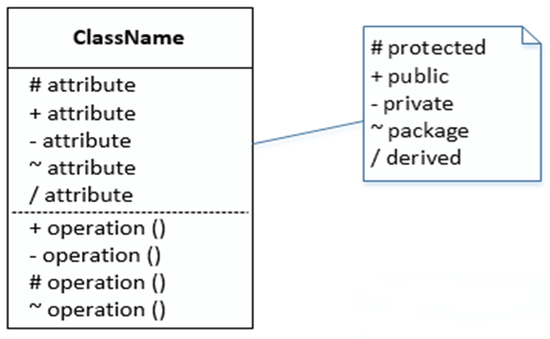
Visibility
The +, - , #, ~, / symbols before an attribute and operation name in a class denote the visibility or accessibility of the attribute and operation.

Slide 8
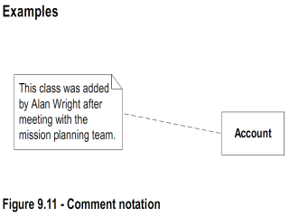
Comments
Represented as a folded note, attached to the appropriate class/method/etc by a dashed line.

Slide 9
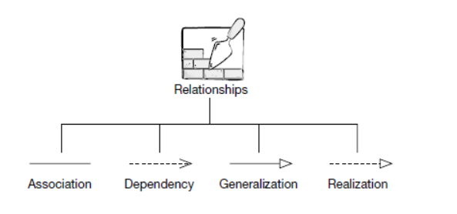
Types of relationships

Slide 10
Relationship between classes
Dependency:
Dependency depicts how various things within a system are dependent on each other. In UML, a dependency relationship is a kind of relationship in which a one element (client) is dependent on another element (supplier).
Which indicates that a change to the supplier necessitates a change to the client.

Slide 11
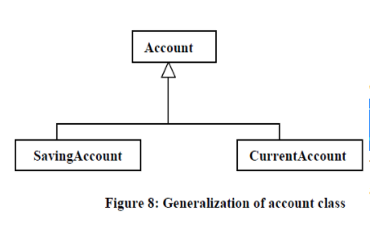
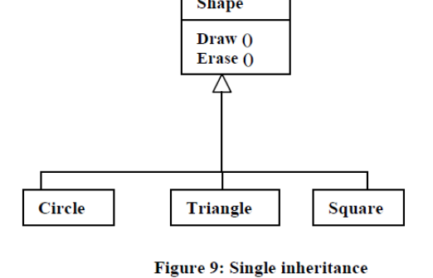
Generalization vs inheritance
Generalization is used to refer to the relationship among classes, and inheritance is used for sharing attributes and operations using the generalization relationship.

Slide 12
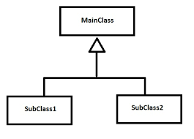
Relationship between classes
Generalization / Inheritance:
It is also called a parent-child relationship.
In a generalization relationship, one entity is a parent, and another is said to be as a child.
A child object can add its functionality to itself as well as inherit the structure and behavior of a parent object.
Arrows point upward to parent
Shown by empty arrow.

Slide 13
Relationship between classes
Realization:
It specifies that the realizing specifier must conform to the contract that the providing interface specifies.
It exists between two objects.
Represents by “dotted arrow" relationship.
In Realization, in order to use a Printer, we must first Install its Drivers.

Slide 14
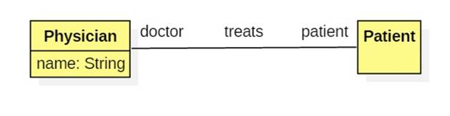
Relationship between classes
Association:
A relationship between instances of two classes where instances of both classes are aware of each other.
In association the objects have their own lifetime and there is no owner.
Association can be one-to-one, one-to-many, many-to-one, many-to-many.
State of class A contains class B.
Represents "has- a" relationship.
Shown by straight line or arrow.

Slide 15
types of Association
Association Types
Uni-Directional Association
Bi-Directional Association
Aggregation
Composition
Asymmetric Reflexive Association
Symmetric Reflexive Association

Slide 16
Association Relationship types
Uni-Directional Association and Bi-Directional Association:
A relationship between instances where an object store a complete other object in its field.
Uni-directional: Book owned by Person.
Bi-directional: Book owned by Person. And Person Own Book.

Slide 17
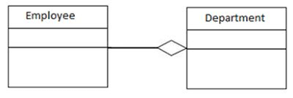
Relationship between classes
Aggregation:
It is a type of weak association.
Each object has its own life cycle but there exists an ownership as well.
Represents by "is part of" relationship.
Denoted by placing a clear diamond.

Slide 18
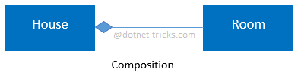
Relationship between classes
Composition:
It is a type of aggregation.
Represents by "is entirely made of" relationship.
In composition, if the engine object is destroyed, then the Car object cease to exist.
Denoted by placing a filled diamond.

Slide 19
Relationship between classes
Asymmetric Reflexive Association and Symmetric Reflexive Association
A link or connection can be present with in the object of same class.
Example: Apple and Mango belong to the Same Fruit Class.
This is called Asymmetric Reflexive Association.

Slide 20
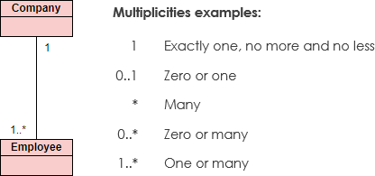
Multiplicity
Documents how many instances of a class can be associated with one instance of another class.
Denotes the minimum number.. maximum number of instances.

Slide 21
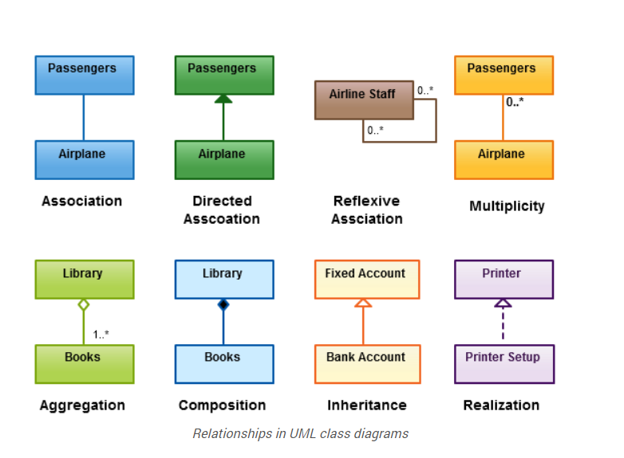
Example of Relationship

Slide 22

TIME TO THINK
Draw Class Diagram for your project????

